Slide 1


Department of ECE
College of Engineering Guindy, Anna University, Chennai
EC-5712 – Project I
Presentation for Review-III
06-11-2024
Hybrid Reversible Zero Watermarking Scheme to Protect
Medical Images
Project Members:
Naveen kumar M (Reg. No.: 2021105329)
Sri Mageshwaran S (Reg. No.: 2021105323)
Gokulnath R (Reg. No.: 2021105714)
Under the Guidance of:
Pushpalatha.V
Assistant professor
Department of ECE
CEG Campus, Anna University

Slide 2

synopsis
Introduction
Project Motivation
Literature Review
Inferences from the literature
Project Objectives
Proposed Methodology
Results and Discussions
Time line
Conclusion
References

Slide 3
Introduction
Authenticity for medical images has become important issue in telemedical applications.
Watermarking plays a vital role in the digital media, primarily by safeguarding intellectual property and ensuring the authenticity of content
Hybrid reversible-zero watermarking (HRZW) component.
Ex: Medical Imaging ,Legal Documents, Digital Art and Photography, Video and Audio Content, Broadcasting etc…

Slide 4
Project Motivation
Zero-watermarking schemes do not modify the original images but generate and store the ownership shares of medical images
Reversible data hiding is a type of data hiding techniques whereby the host image can be recovered exactly but it Needs one time verification
To avoid misclassification of protected images from different persons in the same modality
The illegal use of medical images will cause huge losses to medical institutions

Slide 5
Literature Review
Ref. No. | Publication Details | Methodology | Inference
[1] | Z. Qian, S. Dai, F. Jiang, and X. Zhang, “Improved joint reversible data hiding in encrypted images”, Journal of Visual Communication and Image Representation, vol. 40, pp. 732-738, 2016 | While most techniques of reversible data hiding in encrypted images (RDH-EI) are developed for uncompressed images, this paper provides a separable reversible data hiding protocol for encrypted JPEG bitstream | Message extraction and image recovery are separable, anyone who has the embedding key can extract the message from the marked encrypted copy
[2] | J. Zhou, W. Sun, L. Dong, et al. “Secure reversible image data hiding over encrypted domain via key modulation,” IEEE Transactions on Circuits and Systems for Video Technology, vol. 26, no. 3, pp. 441-452, 2016. | The vendor of the transmission product encrypts the initial information using a public encoding key so embeds a novel fingerprint to spot the customer within the encrypted information | Bit shifting using data hiding in the encrypted image based on bit shifting histogram and proposed method a is robustness is good

Slide 6
Literature Review
Ref. No. | Publication Details | Methodology | Inference
[3] | X. Liao, and C. Shu, “Reversible data hiding in encrypted images based on absolute mean difference of multiple neighboring pixels,” Journal of Visual Communication and Image Repre sentation, vol. 28, pp. 21–27, 2015. | The proposed method takes full advantage of the spatial correlation in the original images to vacate room for embedding data before image encryption | The method adopts an extended run-length coding scheme and a block-based MSB plane rearrangement scheme to efficiently compress the MSB planes
[4] | X. Wu, and W. Sun, “High-capacity reversible data hiding in encrypted images by prediction error,” Signal processing, vol. 104, pp. 387-400, 2014. | The main idea of RDHEI is that an image owner encrypts a cover image, and then a data hider embeds secret information in the encrypted image. With the information hiding key, a receiver can extract the embedded data from the hidden image | The high PSNR value indicated that the visual artifact of the encrypted image was imperceptible to human visual sensitivity. SSIM (Structural Similarity Index Measurement) was used to evaluate the similarity of two images

Slide 7
Literature Review
Ref. No. | Publication Details | Methodology | Inference
[5] | X. Cao, L. Du, X. Wei, et al. “High capacity reversible data hiding in encrypted images by patch-level sparse representation,” IEEE Transactions on Cybernetics, vol. 46, no. 5, pp. 1132-1143, 2016. | Reversible data hiding (RDH) in cover images is a methodology that embeds secret messages into original images, such as law forensics, military, and medical images | The number of incorrectly extracted bits, the payload, and the recovered image quality after message extraction
[6] | F. Huang, J. Huang, and Y. Q. Shi, “New framework for reversible data hiding in encrypted domain”. IEEE Transactions on Information Forensics and Security, vol. 11, no. 12, pp. 2777-2789, 2016. | Hundreds of reversible data hiding (RDH) algorithms have been reported. Via exploring the correlation between the neighboring pixels (or coefficients), | It can accomplish the data hiding by applying the numerous RDH algorithms previously proposed to the encrypted domain directly.

Slide 8
Inferences from the literature
Imperceptibility, robustness, localization, recovery and computation time
Performance of PSNR values
Results demonstrate the effectiveness of the proposed algorithm
At low embedding capacities and mitigates the capacity control problem

Slide 9
Project Objectives
To achieve robust against some malicious attacks such as filtering, noise and clipping attacks.
To determine Continuous verification without verification dispute even after the medical image is restored.
To avoid third party storage requirements
To guarantee the lossless, distinguish ability and robustness of our proposed HRZW.

Slide 10
Methodology
we extract binarized features based on NNGR
logistic-logistic system (LLS) and scrambled on the binarized feature to ensure watermarking
we embed the generated ownership share into the image reversibly based on SLT-SVD-QIM.
Target image is converted to its gray-scale form and then normalized to 512 512 pixels.
Add mathematical equations or any other relevant content that you would like to add.

Slide 11
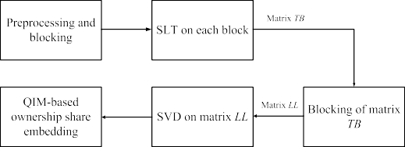
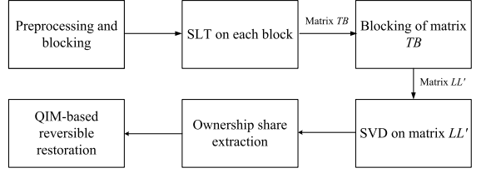
Embedding of ownership share
WORKING
Extraction of ownership share

Slide 12
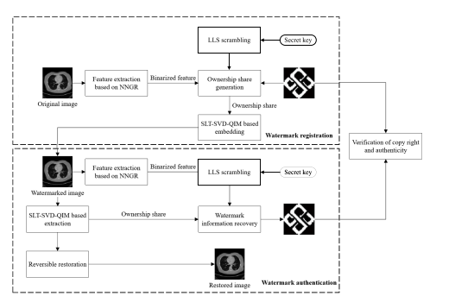
BLOCK DIAGRAM

Slide 13
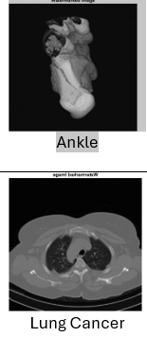


process of Embedding Original image logo ownership share watermarked image
Results and discussions
process of Extraction Watermarked image Extraction of
ownership share logo Recovered image

Slide 14
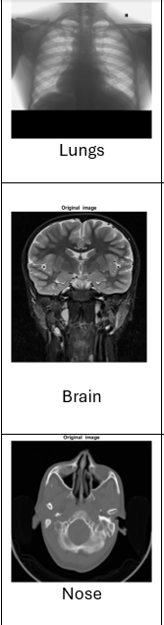
Results and Discussions
Watermarked image
PSNR (Embedding) | Key(0.2 to 1) | PSNR (Extraction) | Authentication
68.3316 | 2 | 75.2320 | Failed
68.9561 | 5 | 75.4767 | Failed
68.4746 | 0.5 | Infinite | Success
68.2263 | 0.6 | Infinite | Success
69.1552 | 0.7 | Infinite | Success

Slide 15
Novelty
Extraction of an image recovered losslessly
SLT provides time localization,smoothness and it defines the tradeoff between impercebality and robustness
SVD enhances watermark robustness
QIM ensures the reversible of medical images without overlapping
The peak signal-to-noise ratio (PSNR) can be infinite when there is no noise. When there is no noise, the two images are identical, and the mean-square error (MSE) is zero. In this case, the PSNR is infinite or undefined.

Slide 16
Timeline

Slide 17
Conclusion
HRZW provides advancements in embedding secret information while preserving the quality of the host medium
This can ensure the accuracy of ownership share for a specific image and avoid third-party storage,
Thus confirming more reliable protection for medical images with better security.

Slide 18
Future Work
semi-fragile watermark must be robust against content-protection image processing.
Semi-fragile watermark resisting to JPEG compression while maintaining high detection ability to tamper
The development of more robust algorithms that can withstand advanced steganalysis techniques is crucial.
This includes improving resistance to various forms of detection and manipulation, ensuring that embedded data remains secure even in adversarial environments

Slide 19
References
Z. Qian, S. Dai, F. Jiang, and X. Zhang, “Improved joint reversible data hiding in encrypted images”, Journal of Visual Communication and Image Representation, vol. 40, pp. 732-738, 2016
J. Zhou, W. Sun, L. Dong, et al. “Secure reversible image data hiding over encrypted domain via key modulation,” IEEE Transactions on Circuits and Systems for Video Technology, vol. 26, no. 3, pp. 441-452, 2016.
X. Liao, and C. Shu, “Reversible data hiding in encrypted images based on absolute mean difference of multiple neighboring pixels,” Journal of Visual Communication and Image Repre sentation, vol. 28, pp. 21–27, 2015.
X. Wu, and W. Sun, “High-capacity reversible data hiding in encrypted images by prediction error,” Signal processing, vol. 104, pp. 387-400, 2014.
X. Cao, L. Du, X. Wei, et al. “High capacity reversible data hiding in encrypted images by patch-level sparse representation,” IEEE Transactions on Cybernetics, vol. 46, no. 5, pp. 1132-1143, 2016.
F. Huang, J. Huang, and Y. Q. Shi, “New framework for reversible data hiding in encrypted domain”. IEEE Transactions on Information Forensics and Security, vol. 11, no. 12, pp. 2777-2789, 2016.

Slide 20


